Slide 1

GUI Calculator with Using Tkinter
Python Project Overview
By Abhishek jain

Slide 2
Project Overview
Objective: Create a GUI-based calculator using Python's tkinter library.
Features:
Addition, Subtraction, Multiply, Division
Square And Square Root
Percentage with Arithmetic operation

Slide 3

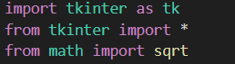
Technology Stack
Programming Language: Python
Library: Tkinter (for GUI)
Mathematical Functions: math module (for square root)

Slide 4
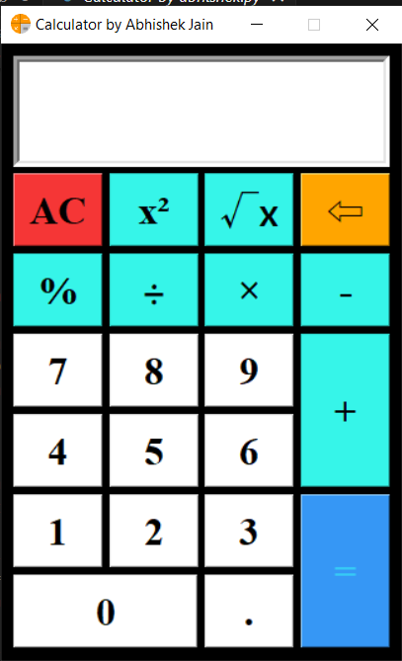
User Interface Design
interface
user
Entry Widget: For displaying the current expression and result.
Buttons: For digits, operators, and special functions.
Basic Operations: +, -, *, /
Special Functions: Square (x²), Square Root (√x)
Percentage Calculation: (%)
Clear and Backspace Functions

Slide 5
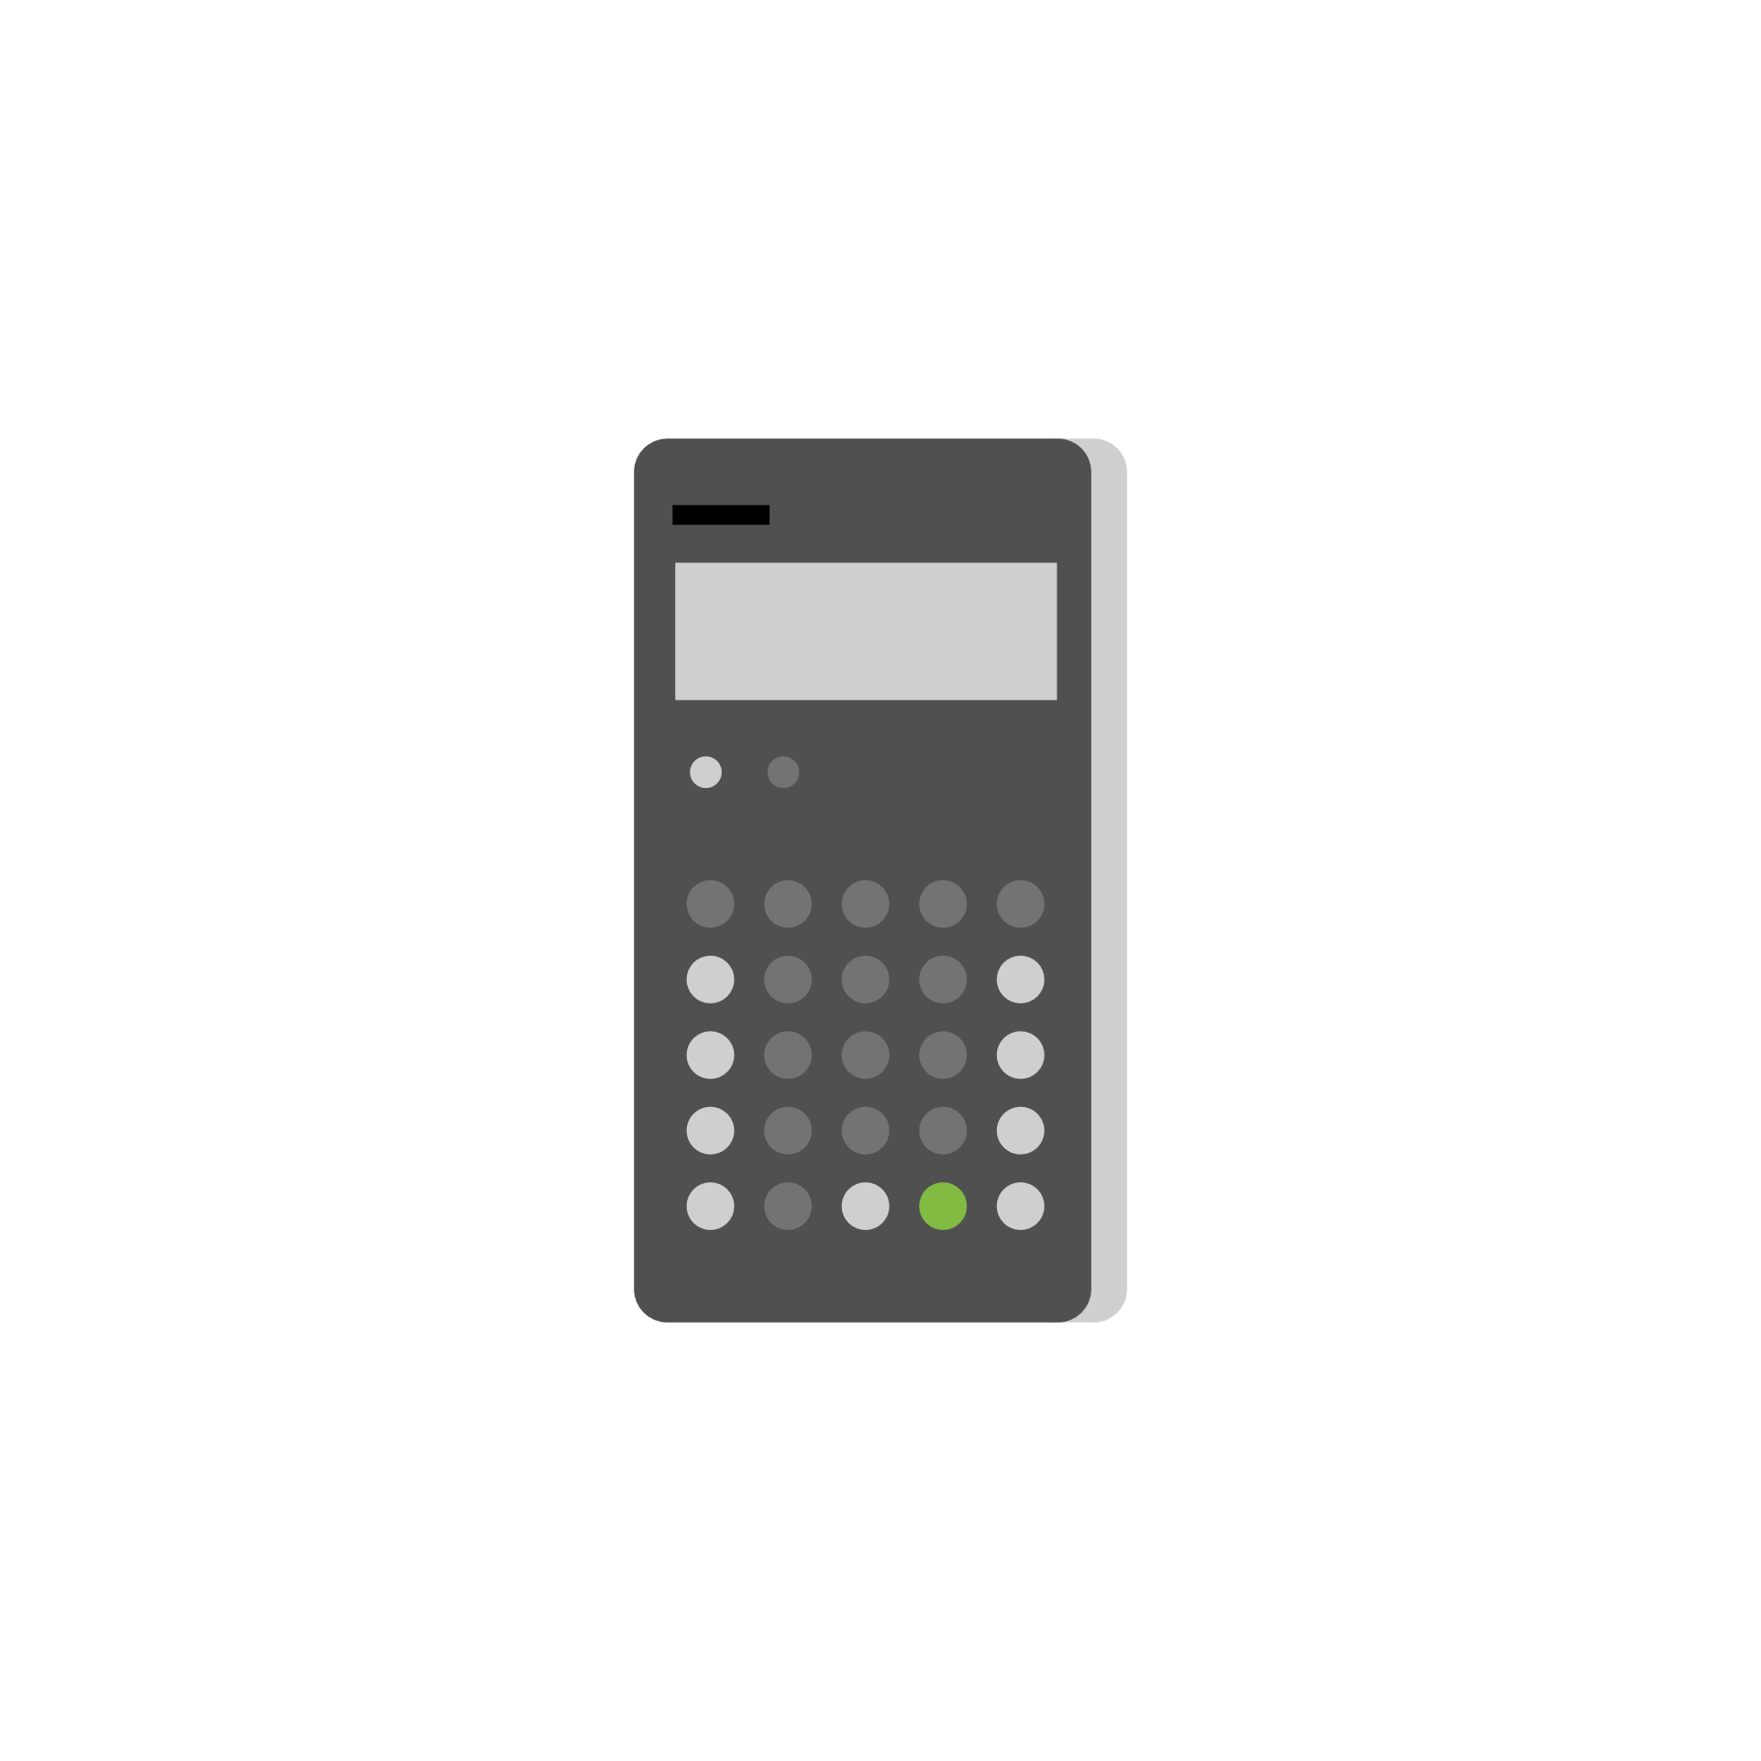
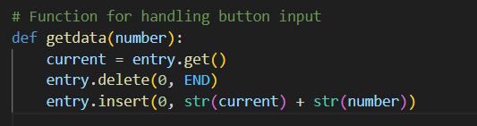
Detailed Code - getdata
Function Purpose: To append a number or operator to the existing input.
Code:

Slide 6
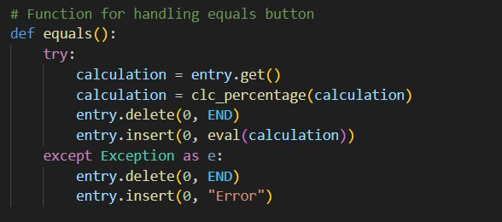

Detailed Code - equals
Function Purpose: To evaluate the mathematical expression and display the result.
Code:

Slide 7
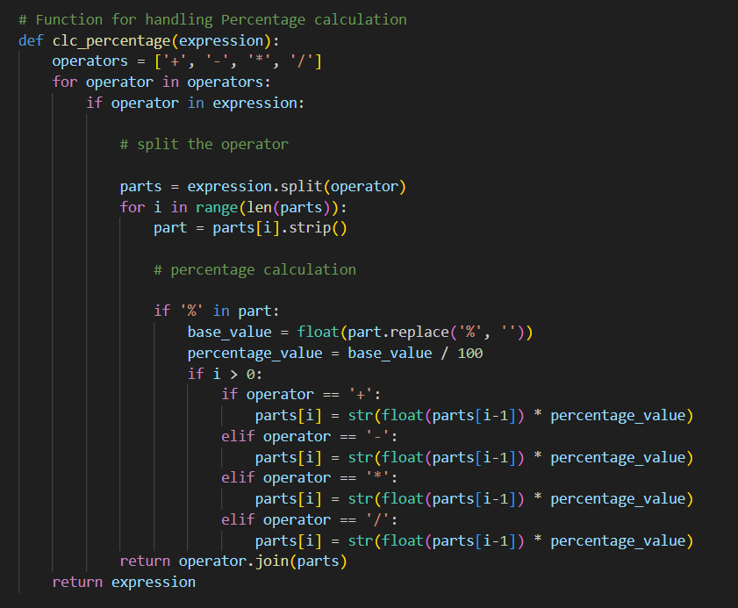
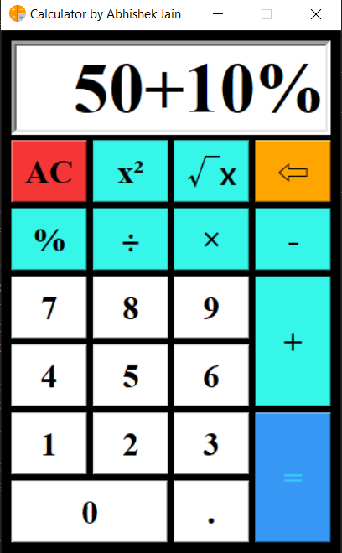
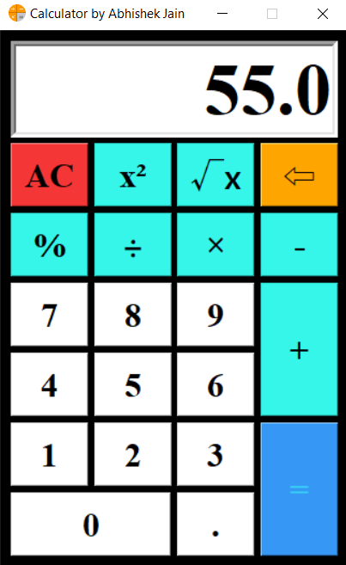
Detailed Code - clc_percentage
Function Purpose: To calculate the percentage value in an expression.
Code:

Slide 8
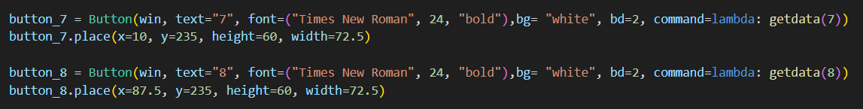

Button Configuration
Creation and Placement:
Each button is created with the Button widget.
Buttons are placed using the place method to position them accurately.
Code Example:

Slide 9
Running the Application
Execution:
The Tkinter event loop is started with win.mainloop().
Running the Script:
Execute the script to launch the calculator application window.

Slide 10

Conclusion
Summary:
Successfully created a basic calculator with Tkinter.
Demonstrated key functionalities and code implementations.
Provided a user-friendly interface for performing arithmetic operations.
Impact:
Useful for educational purposes and as a foundation for more complex applications.

Slide 11
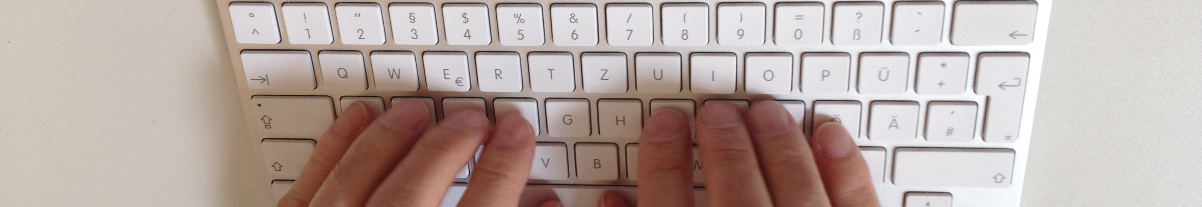
Future amendment
Memory function such as: MR, M+, M-
Scientific function such as: Sin, cos, tan etc.
Check button.
And some other function.
This Photo by Unknown Author is licensed under CC BY-SA

Slide 12
